Slide 1
G.A. Data Science
Final Project Part 1: Lightning Talk
Michael Wong

Slide 2



Timeline & Topics
1: Lightning
Talk
2: Research
Design
3: Exploratory
Analysis
4: Model
Development
5: Presentation
8/16
3 topics x 1 minute
9/11
Research & Write-up: problem statement, scope, hypothesis, approach, data sets, risks/issues, resources
9/18
Python Notebook: imported and validated data, basic statistics and visualization, correlations
9/25
Python Notebook: code and markup, visualizations of results, analysis and conclusions, improvements
10/2
10 minutes

Slide 3



1: Real Estate Markets
Hypothetical Correlations: | Property Prices | Rents
Number of Housing Units | Negative | Negative
Vacancy rates | Negative | Negative
Population | Positive | Positive
Employment | Positive | Positive
Household income | Positive | Positive
Education levels | Positive | Positive

Slide 4



1: Real Estate Markets
Research
Kaggle
Data Sources

Slide 5



2: Spot Election
Hypothetical Correlations: | Incumbent Party Candidate Victory
GDP | Positive
GDP Growth | Positive
Inflation | Negative
Incumbent Candidate | Positive
Duration of Party in Power | Negative
War and Terrorism | Neutralizes negative economic conditions

Slide 6
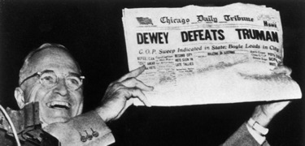
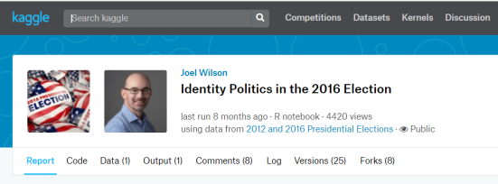

2: Spot Election
Research
Kaggle
Data Sources

Slide 7

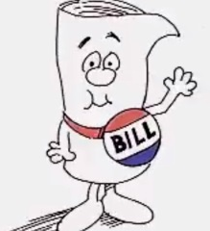

3: Product Sentiment

Slide 8




3: Product Sentiment

